Slide 1

APPLICATIONS OF ASSET TOKENIZATION CONTRACTS: INDIVIDUAL PRODUCT TOKENISATION FOR DECENTRALISED E-COMMERCE
Chaitanya Joshi - 10612653
Harshit Tekchandani - 10628566
Ishita Dubey - 10579030
Siddhi Kelshikar - 10627249

Slide 2
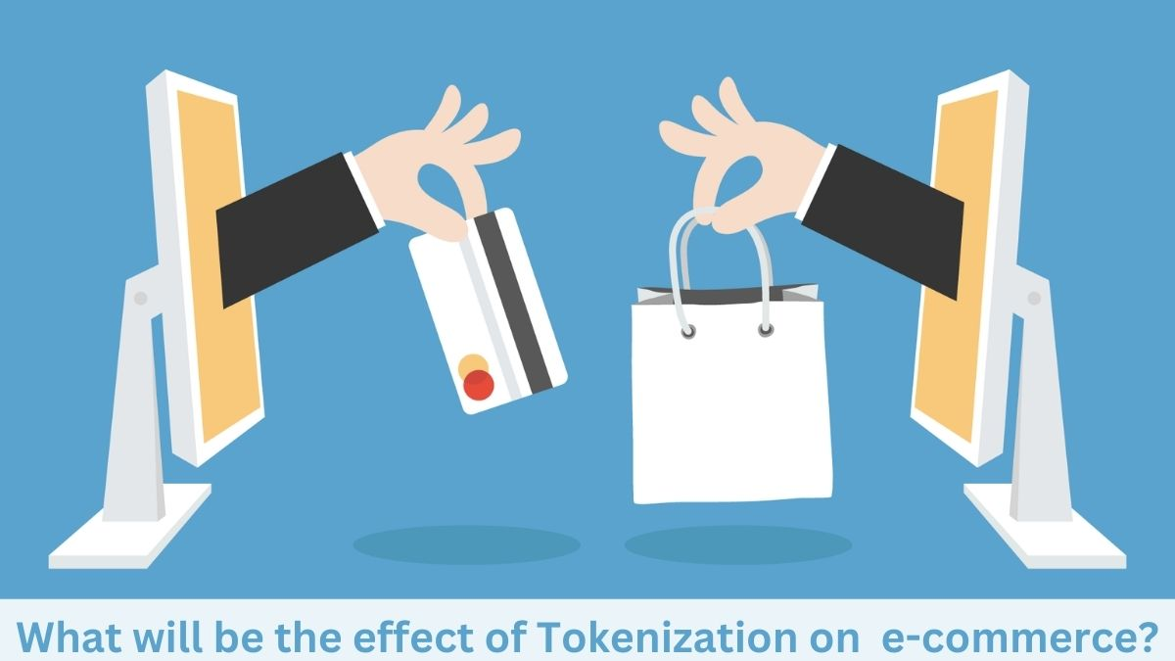
ASSET TOKENIZATION IN E-COMMERCE
Transparency
Decentralization
Fractional ownership
Payment systems
Payment processing
Smart contracts
Product authenticity
Supply chain management
Loyalty programs
Dispute resolution
Non-fungible tokens (NFTs):
Real estate
Luxury goods

Slide 3

APPLICATION OF ASSET TOKENIZATION IN LOYALTY PROGRAMS
Increased engagement
Reduced cost
Improved security
Increased transparency
Increased flexibility

Slide 4

CHALLENGES FOR ASSET TOKENIZATION IN E-COMMERCE
Regulatory Compliance
Technical Complexity
Security Concerns
Liquidity
Valuation

Slide 5

CASE STUDY
Payment tokenization
How does tokenization work
Collect payment details
Generate a token
Send token to the payment processor
Encrypt the token and send to ACH network
Authorize and notify relevant parties
Examples of payment tokenization

